Slide 1
AIML Solution Building – Campus Solutions TEAM 4 THEME - Healthcare Payer / Health Insurance Space in the United State of America Market
<Lead Name>
Sept, 29 2020

Slide 2



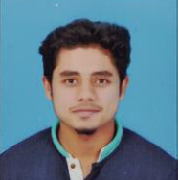


Introduction
Introduction
Problem Statement
Functional View
SUMIT ANAND
NISHANT TYAGI
Saurav c.v.
MS Surya VARDHAN REDDY
Harinatha reddy gajulapalli
Jane Doe
Jane Doe
Jane Doe
Jane Doe
Jane Doe
Design Details
B Tech
B Tech
MBA
ANALYTICS & MARKETING
MBA
ANALYTICS & MARKETING
B tech
Demo Application
IIM Kashipur
IIM Kashipur
SJB Institute of Technology
Sree Vidyanikethan Engineering College
Sree Vidyanikethan Engineering College
Conclusion
Business Cipher Season 3 Finalist
Business Cipher Season 3 Finalist
NeuralHack Season 4 (Python Track) Finalist
NeuralHack Season 4 (Python Track) Finalist
NeuralHack Season 4 (Python Track) Finalist

Slide 3
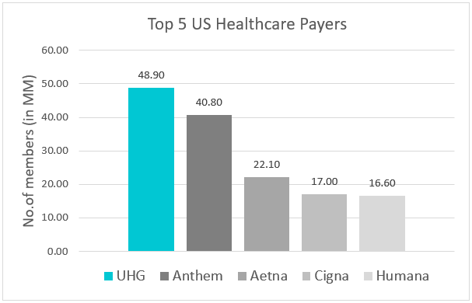





Problem Statement
Virtusa Healthcare Segments
Providers & Health Systems
Healthcare Solution Vendors
Payers
Healthcare Claims Processing – Claims Intake Anomaly Detection (Related to Benefit Configuration)
Introduction
Who is a Payer?
Company that Pays for an administered medical service.
Problem Statement
Processing of patient eligibility, enrollment, claims, and payment.
90
MM
Centers for Medicare & Medicaid Services (CMS) is the largest payer.
~
Functional View
Our focus
Existing workflow
Design Details
Claims submitted
Payer pays claims to healthcare provider
Payment received by healthcare provider
Our journey
What we thought
What it really was
Dataset
Demo Application
Source: CMS
Observations: ~588K
Where we come in
Claims submitted
Payer pays claims to healthcare provider
Payment received by healthcare provider
AnoMLAI
Conclusion
Frauds
AnoMLAI

Slide 4


Slide 5

Machine Learning Model
Pipeline
Introduction
Database
Data
Problem Statement
Application Server
Machine Learning Model
Training (Machine Learning Algorithm)
Functional View
Web services
Design Details
Write
Webserver
Demo Application
AWS Instance
Jupyterhub
User
Database
Conclusion
Prediction Rest API call
Client Browser

Slide 6
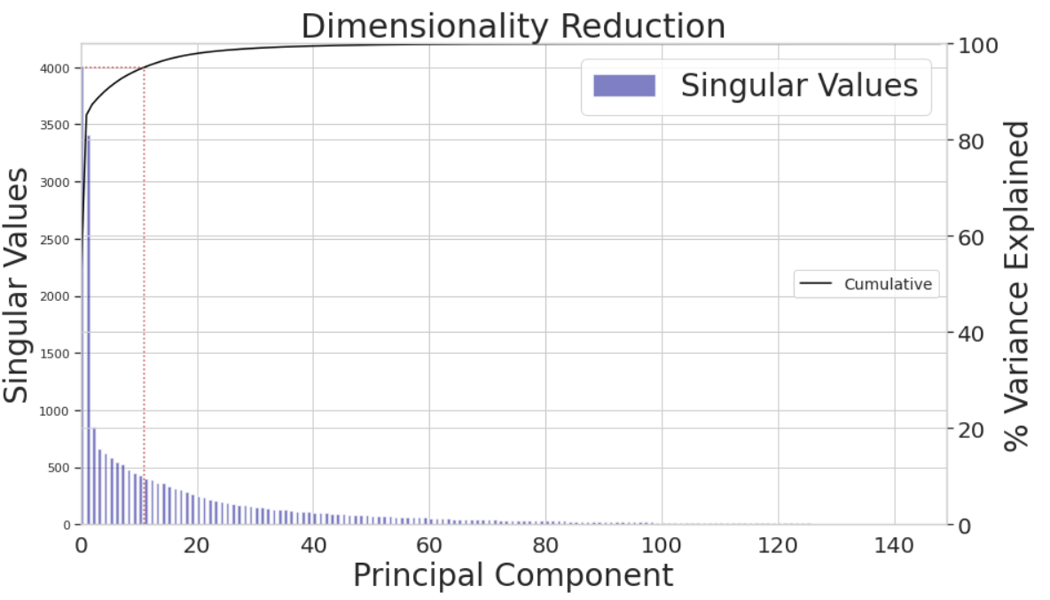
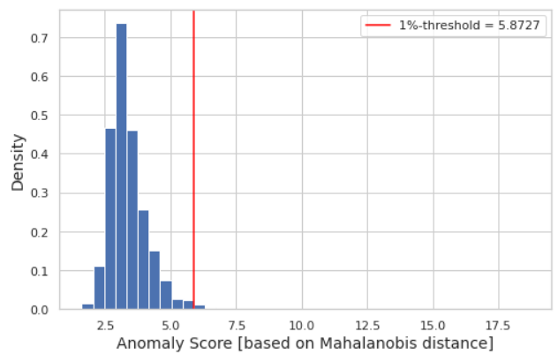
Inputs
Unsupervised Anomaly Detection
PCA
Beneficiary Gender Code
Beneficiary Age Category Code
.
.
.
.
DRG quintile average payment amount
95%
Introduction
Variance explained by 12 components
Problem Statement
Score
Functional View
Data Preprocessing
> Threshold
Mapped codes to definitions
Missing Value Analysis
Little’s MCAR -> Imputation
NLP for textual features
Anomaly
Design Details
Labelled Anomalies
Supervised Anomaly Detection
Demo Application
Feature Engineering
Preprocessing
Modelling
Evaluation
Deployment
Checked similarity for words with opposite severity
Calculated mean of word vectors to derive embeddings
Stratified Train-Test Split
Logistic Regression
Confusion Matrix
Pickling
Conclusion
80%
Training Data
Hyperparameter Tuning
20%
Test Data
GridsearchCV
CV:5, Scoring:’f1’
Best Param- C:0.1
Memory
Stratified Train-Test Split
Pipeline
Steps-
1.Standard Scaler 2.Classifier
To ensure uniform proportion of amount codes.
Random Forest Classifier
Cross Validated (n_splits=5)
ROC
AUC
Serialization
De-Serialization
30%
Test Data
70%
Training Data
Disk
(Standard Scaled)

Slide 7
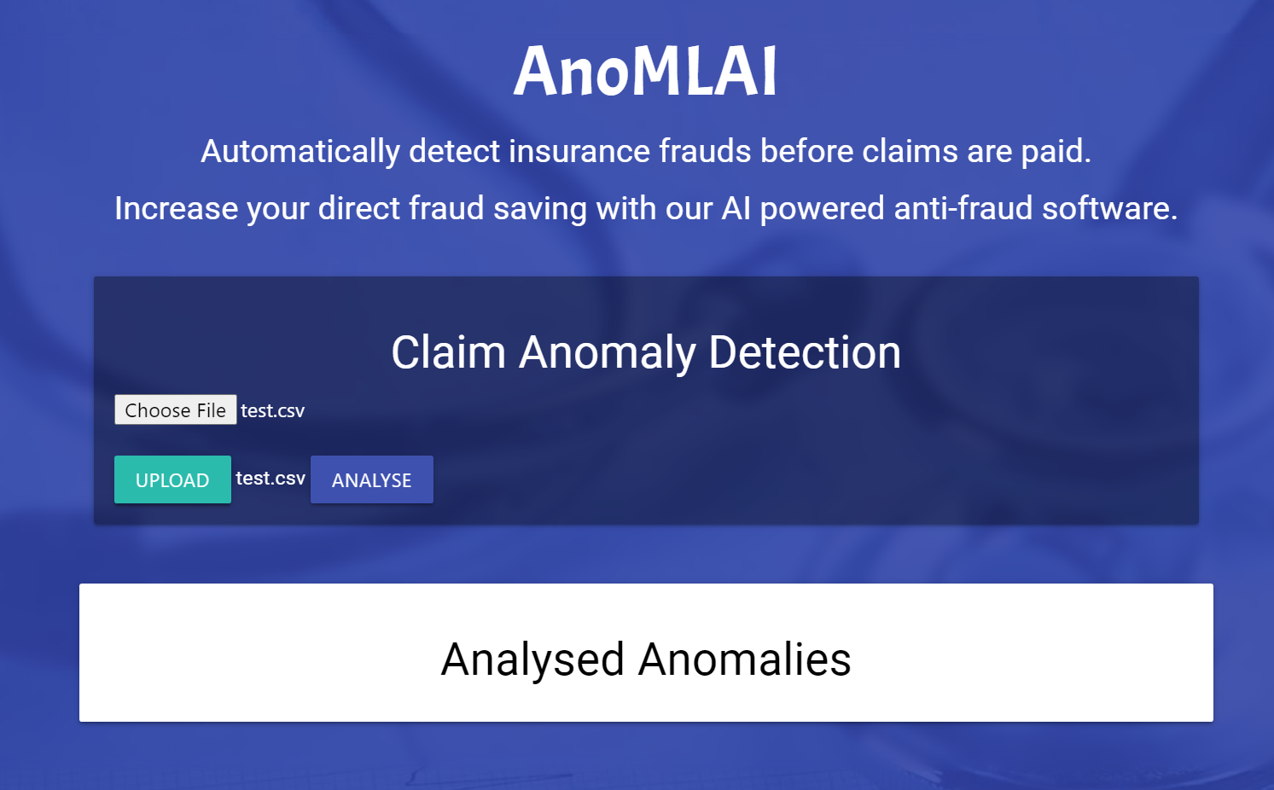
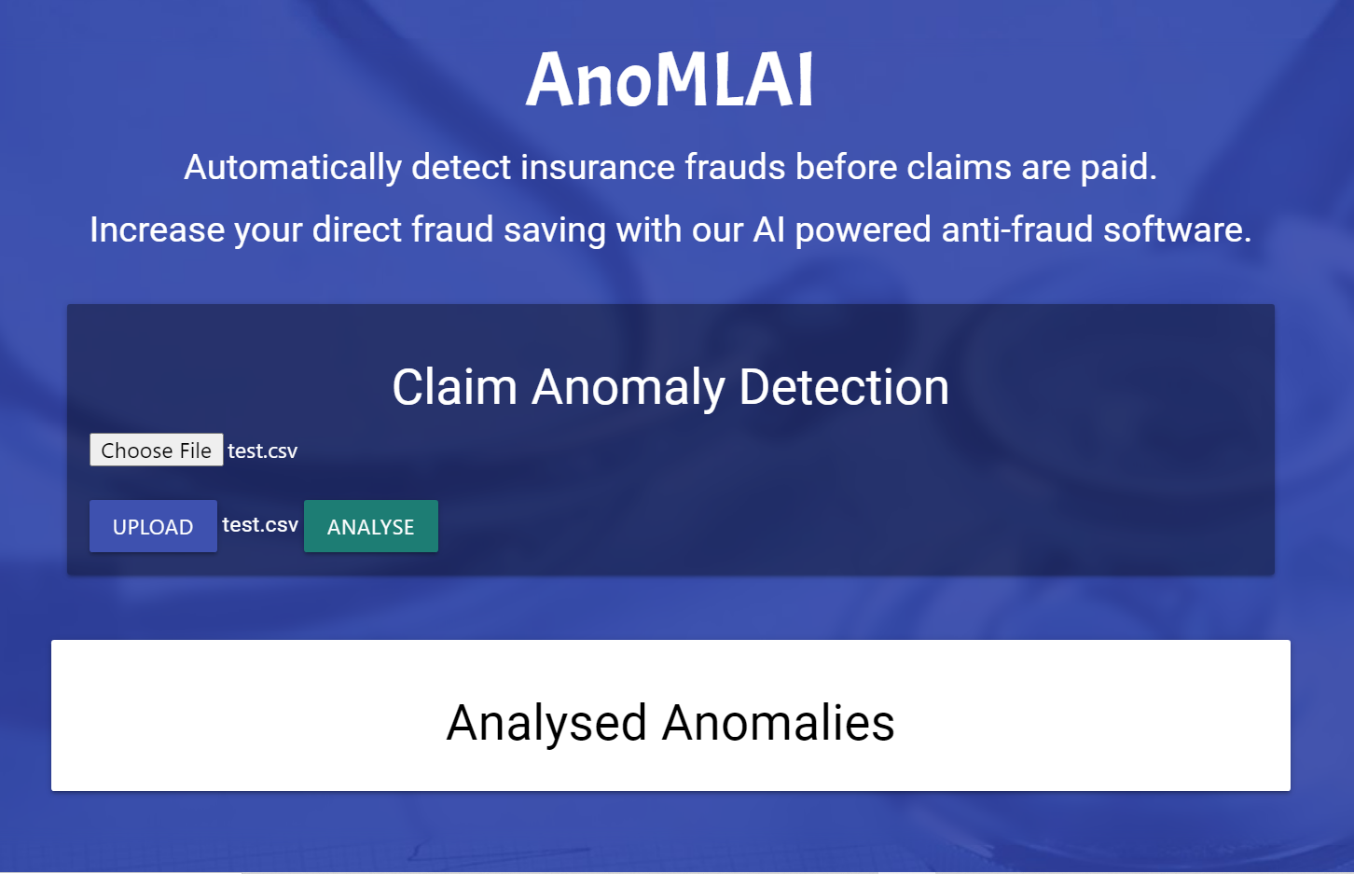
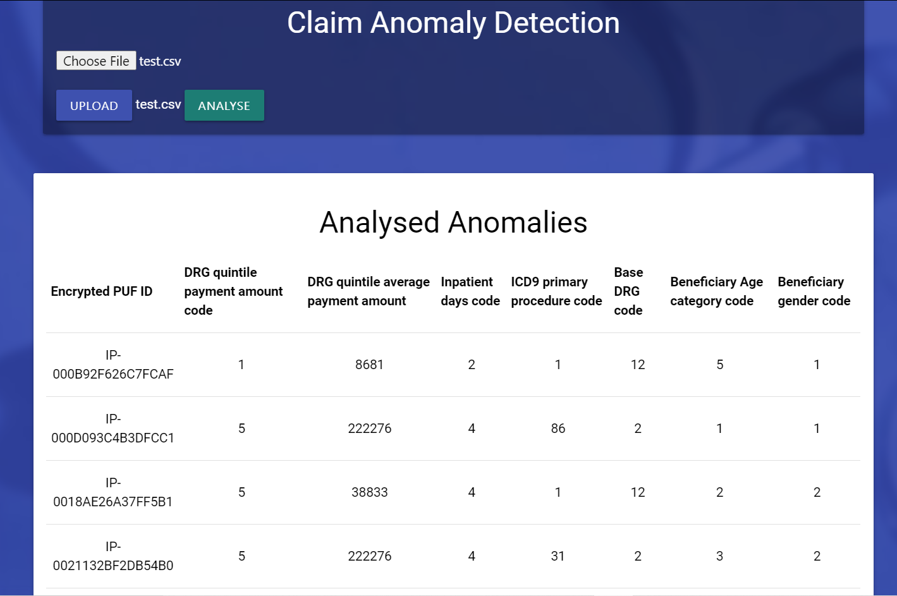
1
2
Introduction
Problem Statement
Functional View
Design Details
Demo Application
Conclusion
Choose and Upload file
Click on Analyse

Slide 8
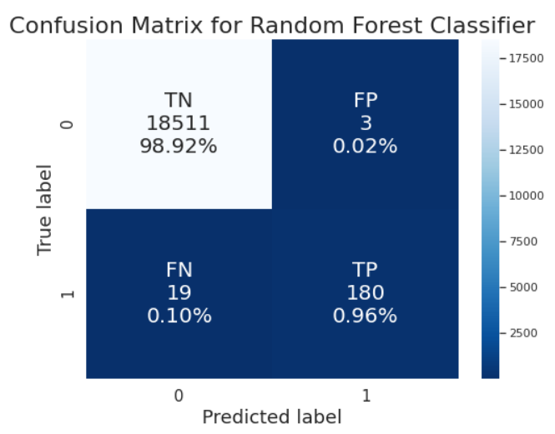
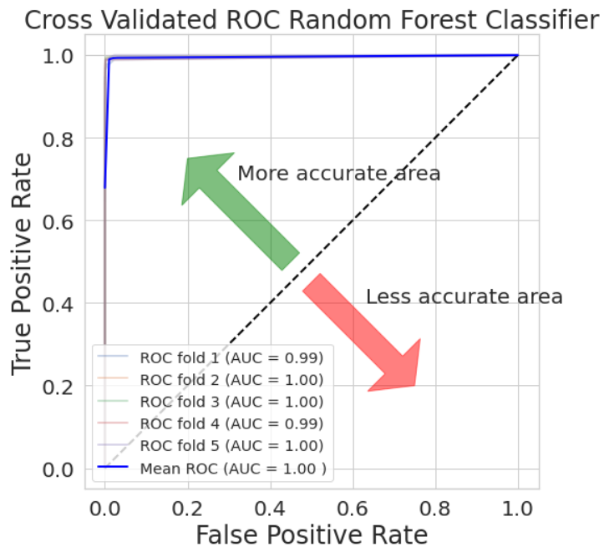
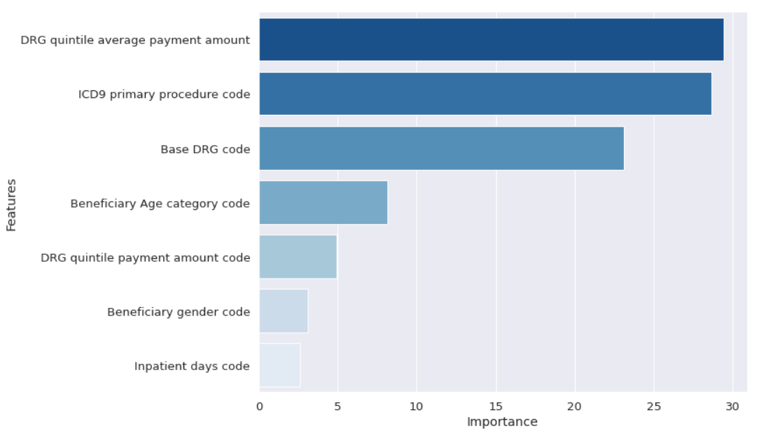
Test Results
DRG quintile average payment amount
Introduction
ICD9 primary procedure code
Base DRG code
Problem Statement
Functional View
Design Details
Recommendations
Demo Application
Model perspective
Business perspective
Scalability: AnoMLAI is a scalable software which uses algorithm efficient at handling large databases.
Broad Scope: In future it can be used as fraud detection and prevention software by adding few features to it.
Feature Importance: The estimates of importance could be used for pre-emptive measures.
Subscription Model: AnoMLAI as a subscription based software for capitalizing on the compounding value of customer relationships.
Customized Services: Value added offering through support to end user. e.g. Cigna may have specific set of requirements pertaining to the implementation.
Conclusion

Slide 9
Thank You

